Slide 1
Neural Networks
Course 3: Gradient Descent

Slide 2
Overview
Feed Forward Network Architecture
Cost Function
Gradient Descent

Slide 3
Neuron unit

Slide 4
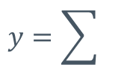

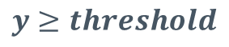
Neuron unit
We know that a perceptron can be described in the following way:
Input₁
weight₁
Input₂
weight₂
$$y=\sum{}$$
weight₃
$$y≥threshold$$
Input₃
weight_{n}
Input_{n}
$$y=\sum_{i=1}^{n}{{Input}_{i}×{weight}_{i}}, y≥threshold$$

Slide 5
Neuron unit
But we can view a perceptron as a unit formed out of the following components:
Weights (a vector of weights)
Sums up function (a function that computes the dot product between the vector of weights and its input)
Activation function (a function that takes the result of the previous function and convert that scalar value into another value).

Slide 6
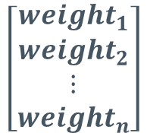
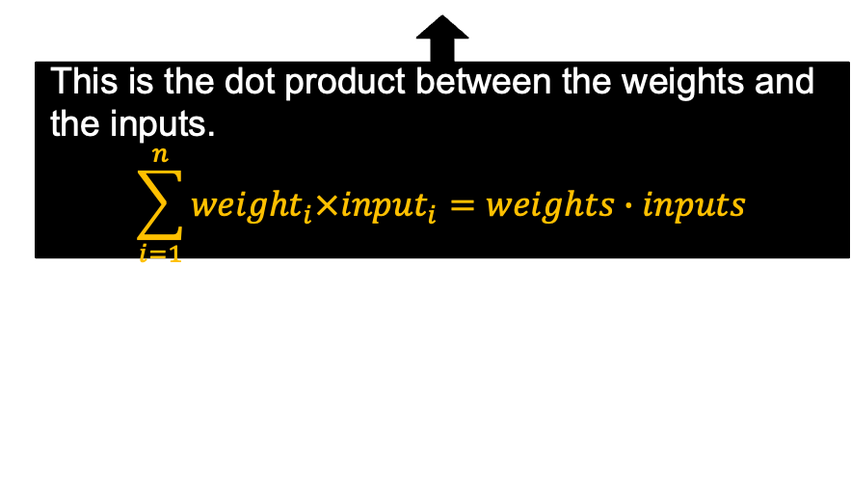

Neuron unit
This means that we can organize a perceptron in the following layers:
$$\left[\begin{matrix}{weight}_{1} \\ {weight}_{2} \\ \begin{aligned}⋮ \\ {weight}_{n}\end{aligned}\end{matrix}\right]$$
weights
Dot Product
This is the dot product between the weights and the inputs. $$\sum_{i=1}^{n}{{weight}_{i}×{input}_{i}}=weights∙inputs$$

Slide 7

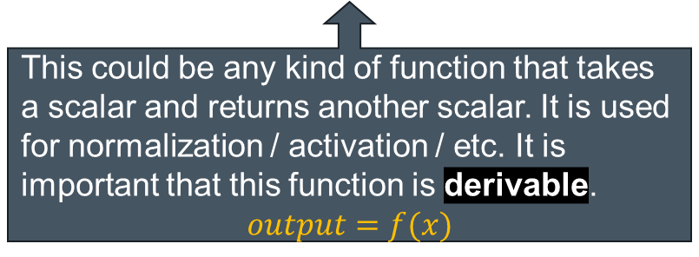
Neuron unit
This means that we can organize a perceptron in the following layers:
$$\left[\begin{matrix}{weight}_{1} \\ {weight}_{2} \\ \begin{aligned}⋮ \\ {weight}_{n}\end{aligned}\end{matrix}\right]$$
weights
Dot Product
Activation
This could be any kind of function that takes a scalar and returns another scalar. It is used for normalization / activation / etc. It is important that this function is derivable.
$$output=f(x)$$

Slide 8
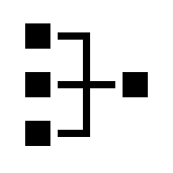
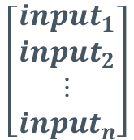
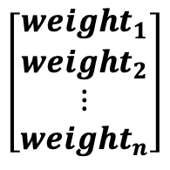

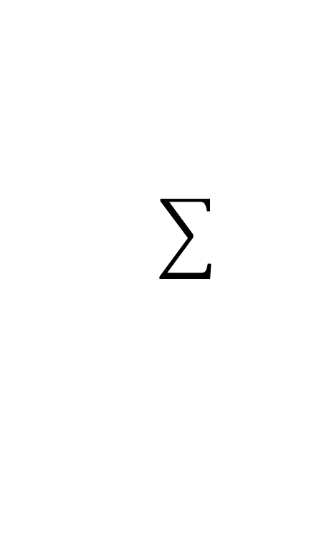
Neuron unit: notations
Neuron Unit
$$\left[\begin{matrix}{input}_{1} \\ {input}_{2} \\ \begin{aligned}⋮ \\ {input}_{n}\end{aligned}\end{matrix}\right]$$
$$\left[\begin{matrix}{weight}_{1} \\ {weight}_{2} \\ \begin{aligned}⋮ \\ {weight}_{n}\end{aligned}\end{matrix}\right]$$
Scalar
Value
Output
weights
Dot Product
Activation
$$\left[\begin{matrix}{input}_{1} \\ {input}_{2} \\ \begin{aligned}⋮ \\ {input}_{n}\end{aligned}\end{matrix}\right]$$
Neuron Unit
Output

Slide 9

Neuron unit: notations
x
w
z
y
Neuron Unit
$$\left[\begin{matrix}{input}_{1} \\ {input}_{2} \\ \begin{aligned}⋮ \\ {input}_{n}\end{aligned}\end{matrix}\right]$$
$$\left[\begin{matrix}{weight}_{1} \\ {weight}_{2} \\ \begin{aligned}⋮ \\ {weight}_{n}\end{aligned}\end{matrix}\right]$$
Scalar
Value
Output
weights
Dot Product
Activation
$$z=\sum_{i=1}^{n}{{Input}_{i}×{weight}_{i}}+b = x⋅w+b$$
$$y=activation(z)$$

Slide 10
Neuron Unit: Activation functions
Activation functions were named like this because they replicated the activation process of a biological neuron.
Activate (output 1) when weighted input is greater than a threshold.
In practice, some of the activation functions don’t do this, they just transform the input into another value (for example there are activation functions that perform normalization tasks).

Slide 11

Neuron Unit:
Linear activation:
This is not really a function that is being used, more like a method to explain that no activation is needed.
y
$$y=z$$
z

Slide 12



Neuron Unit:
Binary Threshold
If the input is above a threshold then output 1, else output 0 (or -1)
y
y=1
y$=\left\{\begin{aligned}1, if W⋅x>threshold \\ 0 (or −1), otherwise\end{aligned}\right.$
$$threshold$$
$$W⋅x$$

Slide 13



Neuron Unit:
Binary Threshold
If the input is above a threshold then output 1, else output 0 (or -1)
y
y=1
y$=\left\{\begin{aligned}1, if W⋅x>threshold \\ 0 (or −1), otherwise\end{aligned}\right.$
threshold $=−b, then$
$$z$$
y$=\left\{\begin{aligned}1, if w⋅x+b>0 \\ 0, otherwise\end{aligned}\right.$
$$threshold$$
$$W⋅x$$

Slide 14



Neuron Unit:
Binary Threshold
If the input is above 0, output 1, else output 0 (or -1)
y
y=1
y$=\left\{\begin{aligned}1, if z≥threshold \\ 0 (or −1), otherwise\end{aligned}\right.$
Threshold is usually learned as any other weight, considering input has another dimension with value 1
$$0$$
$$z$$
Notes:
Spune ca z-ul contine deobicei threshold

Slide 15

Feed Forward Network Architecture
Why not use the binary threshold activation?
Not derivable
Also, no change in output when changing weights by a small value
y=1
$$0$$
$$z$$

Slide 16
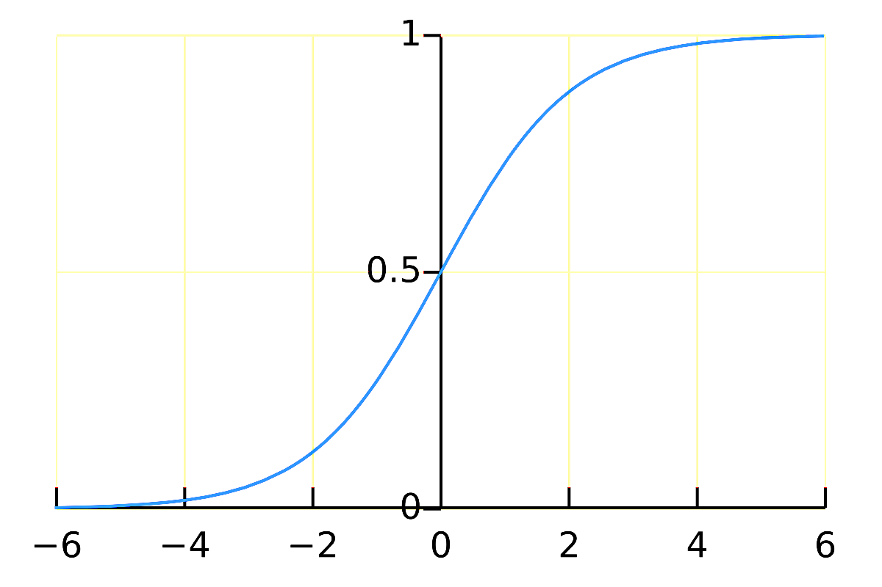

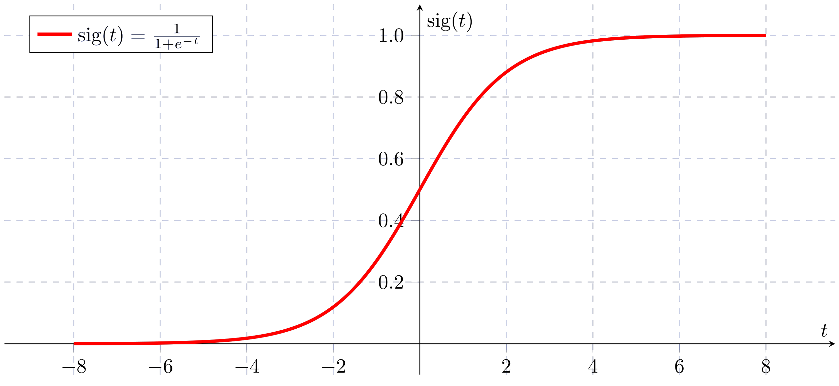
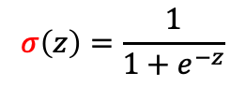

Feed Forward Network Architecture
A smoother version of the threshold activation will be used: the logistic function. (sigmoid)
$y=σ\left(z\right)=\frac{1}{1+e^{−z}}$
$$σ\left(z\right)=\frac{1}{1+e^{−z}}$$

Slide 17
Activation functions
Logistic (sigmoid) function:
The function is always positive
This function normalizes values in 0..1 interval. The larger a value is, the close this functions tends to 1. The lower a number is (into the negative space) the closest the result of this function will be towards 0.
The slope of the function varies. It has a consistent slope on input between [-4,4] and the slope tends to get to 0 outside this interval.
Sigmoid functions are commonly used in the output layer of binary classification neural networks, where they model the probability that an input belongs to one of the two classes.

Slide 18
Neuronal Network Architecture

Slide 19
Neuronal Network Architecture
A neuronal network is a network formed out of multiple neurons organized in layers as follows:
An input layer (a set of neurons – at least one - that receive the input).
Hidden layers (one or more layers of neurons that process the output from the input layer)
Output layer (a final layer that takes values from the previous layer and convert it into the final value).

Slide 20
Neuronal Network Architecture
Observations:
The input layer must have at least one neuron
Hidden layers are optional
The number of neurons in the hidden layers can vary from one hidden layer to another
Output layer consists in one neuron for regression or binary classification, but for multi-class classification it can contain multiple neurons.
A neuronal network with no hidden layer, one neuron in the output layer and with a binary threshold activation is a perceptron

Slide 21

Neuronal Network Architecture
Let’s see a graphical representation of a fully connected neural network: This type of network is also called Multi Layer Perceptron (MLP), but this is confusing, since the perceptron is rarely used in this kind of architecture.
Input
Output
Hidden layers

Slide 22



Neuronal Network Architecture
The same network can be abstracted in the following way:
Fully connected layer
Neuron Unit
Output₁
Neuron Unit
$$\left[\begin{matrix}{output}_{1} \\ {output}_{2} \\ \begin{aligned}⋮ \\ {output}_{k}\end{aligned}\end{matrix}\right]$$
$$\left[\begin{matrix}{input}_{1} \\ {input}_{2} \\ \begin{aligned}⋮ \\ {input}_{n}\end{aligned}\end{matrix}\right]$$
$$input=$$
Output₂
Neuron Unit
Output_{k}

Slide 23







Neuronal Network Architecture
A more detailed view of this architecture looks like this:
Fully connected layer
DotProd₁
Activation₁
Output₁
$$\left[\begin{matrix}{input}_{1} \\ {input}_{2} \\ \begin{aligned}⋮ \\ {input}_{n}\end{aligned}\end{matrix}\right]$$
$$\left[\begin{matrix}{output}_{1} \\ {output}_{2} \\ \begin{aligned}⋮ \\ {output}_{k}\end{aligned}\end{matrix}\right]$$
$$input=$$
Output₂
DotProd₂
Activation₂
DotProd_{k}
Activation_{k}
Output_{k}

Slide 24
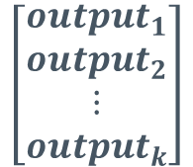
Neuronal Network Architecture
A more detailed view of this architecture looks like this:
Fully connected layer
DotProd₁
Activation₁
Output₁
$$\left[\begin{matrix}{input}_{1} \\ {input}_{2} \\ \begin{aligned}⋮ \\ {input}_{n}\end{aligned}\end{matrix}\right]$$
$$\left[\begin{matrix}{output}_{1} \\ {output}_{2} \\ \begin{aligned}⋮ \\ {output}_{k}\end{aligned}\end{matrix}\right]$$
$$input=$$
Let’s analyze this part of the architecture from a mathematical point of view.
DotProd₂
Activation₂
Output₂
DotProd_{k}
Activation_{k}
Output_{k}

Slide 25







Neuronal Network Architecture
A more detailed view of this architecture looks like this:
While all of these “k” dot products produces individual scalar values, we can also consider that each one of this operations in fact produce a part of a vector.
$$=input∙W_{1}$$
DotProd₁
$$=input∙W_{2}$$
DotProd₂
$$=\left[\begin{aligned}input∙W_{1} \\ input∙W_{2} \\ ⋮ \\ input∙W_{k}\end{aligned}\right]$$
This looks like a matrix multiplication operation !
$$=input∙W_{k}$$
DotProd_{k}

Slide 26
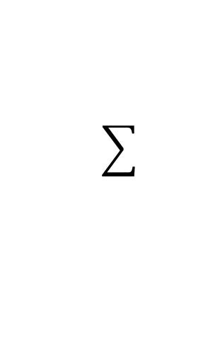
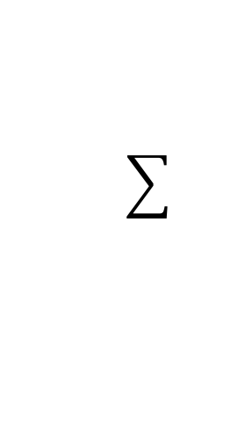
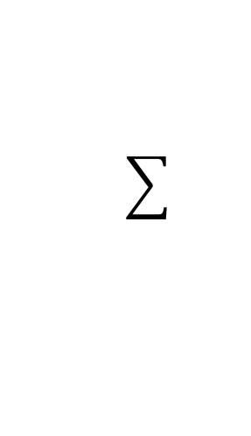

Neuronal Network Architecture
A more detailed view of this architecture looks like this:
$$=input∙W_{1}$$
DotProd₁
$$=input∙W_{2}$$
$$=\left[\begin{matrix}{input}_{1} \\ {input}_{2} \\ \begin{aligned}⋮ \\ {input}_{n}\end{aligned}\end{matrix}\right]×\left[\begin{matrix}W_{(1,1)} & ⋯ & W_{(1,n)} \\ ⋮ & ⋱ & ⋮ \\ W_{(k,1)} & ⋯ & W_{(k,n)}\end{matrix}\right]$$
DotProd₂
$$=input∙W_{k}$$
DotProd_{k}

Slide 27
Neuronal Network Architecture
A more detailed view of this architecture looks like this:
$$=input∙W_{1}$$
DotProd₁
$$=input∙W_{2}$$
$$=\left[\begin{matrix}{input}_{1} \\ {input}_{2} \\ \begin{aligned}⋮ \\ {input}_{n}\end{aligned}\end{matrix}\right]×\left[\begin{matrix}W_{(1,1)} & ⋯ & W_{(1,n)} \\ ⋮ & ⋱ & ⋮ \\ W_{(k,1)} & ⋯ & W_{(k,n)}\end{matrix}\right]$$
DotProd₂
$$=input∙W_{k}$$
Where W_{(k,1)}…W_{(k,n)} are the weights associates with NeuronUnit_{k}
DotProd_{k}

Slide 28




Neuronal Network Architecture
So, in fact, we can see a part of the original architecture presented as follows:
Fully connected layer
 | 1 | 2 | … | n
1 | W_{1,1} | W_{1,2} | … | W_{1,n}
2 | W_{2,1} | W_{2,2} | … | W_{2,n}
3 | W_{3,1} | W_{3,2} | … | W_{2,n}
4 | W_{4,1} | W_{4,2} | … | W_{3,n}
5 | W_{5,1} | W_{5,2} | … | W_{4,n}
…
k | W_{k,1} | W_{k,2} | … | W_{k,n}
$$\left[\begin{matrix}{input}_{1} \\ {input}_{2} \\ \begin{aligned}⋮ \\ {input}_{n}\end{aligned}\end{matrix}\right]$$
$$\left[\begin{matrix}{result}_{1} \\ {result}_{2} \\ \begin{aligned}⋮ \\ {result}_{k}\end{aligned}\end{matrix}\right]$$
$$\left[\begin{matrix}{output}_{1} \\ {output}_{2} \\ \begin{aligned}⋮ \\ {output}_{k}\end{aligned}\end{matrix}\right]$$
$$⋅$$
Activation

Slide 29
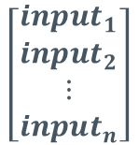
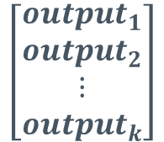
Neuronal Network Architecture
So, in fact, we can see a part of the original architecture presented as follows:
Is it OK to apply the activation function over a vector and not a scalar as it was initially designed ?
Fully connected layer
 | 1 | 2 | … | n
1 | W_{1,1} | W_{1,2} | … | W_{1,n}
2 | W_{2,1} | W_{2,2} | … | W_{2,n}
3 | W_{3,1} | W_{3,2} | … | W_{2,n}
4 | W_{4,1} | W_{4,2} | … | W_{3,n}
5 | W_{5,1} | W_{5,2} | … | W_{4,n}
…
k | W_{k,1} | W_{k,2} | … | W_{k,n}
$$\left[\begin{matrix}{input}_{1} \\ {input}_{2} \\ \begin{aligned}⋮ \\ {input}_{n}\end{aligned}\end{matrix}\right]$$
$$\left[\begin{matrix}{result}_{1} \\ {result}_{2} \\ \begin{aligned}⋮ \\ {result}_{k}\end{aligned}\end{matrix}\right]$$
$$\left[\begin{matrix}{output}_{1} \\ {output}_{2} \\ \begin{aligned}⋮ \\ {output}_{k}\end{aligned}\end{matrix}\right]$$
X
Activation

Slide 30


Neuronal Network Architecture
The activation function was defined as follows:
$$y_{i}=activation\left(z_{i}\right), with z_{i},y_{i}=scalars$$
Activation
We can convert it to serve the same purpose as follows:
$$z = \left[\begin{aligned}z_{1} \\ z_{2} \\ ⋮ \\ z_{n}\end{aligned}\right]y=\left[\begin{aligned}activation(z_{1}) \\ activation(z_{2}) \\ ⋮ \\ activation(z_{n})\end{aligned}\right]$$
The main advantage when using this type of form is that you can also apply the activation function to the entire vector and not just for individual scalars.

Slide 31







Neuronal Network Architecture
Or a more simplified version of a fully connected layer:
Fully connected layer
n→k
 | 1 | 2 | … | n
1 | W_{1,1} | W_{1,2} | … | W_{1,n}
2 | W_{2,1} | W_{2,2} | … | W_{2,n}
3 | W_{3,1} | W_{3,2} | … | W_{2,n}
4 | W_{4,1} | W_{4,2} | … | W_{3,n}
5 | W_{5,1} | W_{5,2} | … | W_{4,n}
…
k | W_{k,1} | W_{k,2} | … | W_{k,n}
$$\left[\begin{matrix}{input}_{1} \\ {input}_{2} \\ \begin{aligned}⋮ \\ {input}_{n}\end{aligned}\end{matrix}\right]$$
$$\left[\begin{matrix}{result}_{1} \\ {result}_{2} \\ \begin{aligned}⋮ \\ {result}_{k}\end{aligned}\end{matrix}\right]$$
$$\left[\begin{matrix}{output}_{1} \\ {output}_{2} \\ \begin{aligned}⋮ \\ {output}_{k}\end{aligned}\end{matrix}\right]$$
$$\left[\begin{matrix}{input}_{1} \\ {input}_{2} \\ \begin{aligned}⋮ \\ {input}_{n}\end{aligned}\end{matrix}\right]$$
$$\left[\begin{matrix}{output}_{1} \\ {output}_{2} \\ \begin{aligned}⋮ \\ {output}_{k}\end{aligned}\end{matrix}\right]$$
X
Activation

Slide 32


Neuronal Network Architecture
As a result, we can describe a fully connected neuronal network as follows:
m₁→m₂
m₂→m₃
m_{p-1}→m_{p}
m_{p}→k
$$\left[\begin{matrix}{input}_{1} \\ {input}_{2} \\ \begin{aligned}⋮ \\ {input}_{n}\end{aligned}\end{matrix}\right]$$
$$\left[\begin{matrix}{output}_{1} \\ {output}_{2} \\ \begin{aligned}⋮ \\ {output}_{k}\end{aligned}\end{matrix}\right]$$
Input Layer
Hidden Layers
Output Layer

Slide 33

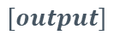
Neuronal Network Architecture
Let’s see a more practical example with a fully connected neuronal network with 3 inputs, 2 hidden layers of 4 and 2 neurons and one output.
3→4
4→2
2→1
$$\left[\begin{matrix}{input}_{1} \\ {input}_{2} \\ \begin{aligned}⋮ \\ {input}_{n}\end{aligned}\end{matrix}\right]$$
$$\left[output\right]$$
Input Layer
Hidden Layers
Output Layer

Slide 34


Feed Forward Network Architecture
The neurons from the hidden layer should have a non-linear, derivable activation function.
Example: Let’s say we have a neural network with 1 hidden layer, 1 output layer and linear activation function. (so no activation)
m₁→m₂
m₂→k
$$\left[\begin{matrix}{input}_{1} \\ {input}_{2} \\ \begin{aligned}⋮ \\ {input}_{n}\end{aligned}\end{matrix}\right]$$
$$\left[\begin{matrix}{output}_{1} \\ {output}_{2} \\ \begin{aligned}⋮ \\ {output}_{k}\end{aligned}\end{matrix}\right]$$
Input Layer
Hidden Layer
Output Layer

Slide 35




Feed Forward Network Architecture
Example: Let’s say we have a neural network with 1 hidden layer, 1 output layer and linear activation function. (so no activation)
$$z_{1}=w_{1}input+b_{1} \\ y_{1}=z_{1} \\ z_{2}=w_{2}y1+b_{2} \\ output=z_{2}$$
$$output=w_{2}\left(w_{1}input+b_{1}\right)+b_{2}$$
$$output=w_{2}w_{1}input+w_{2}b_{1}+b_{2}$$
We’ve obtained a linear activation of the input. Just like we had only one layer
$$output= w^{′} input + b′$$
Notes:
https://playground.tensorflow.org/#activation=sigmoid&batchSize=10&dataset=circle&regDataset=reg-plane&learningRate=0.1&regularizationRate=0&noise=0&networkShape=3&seed=0.04528&showTestData=false&discretize=false&percTrainData=50&x=true&y=true&xTimesY=false&xSquared=false&ySquared=false&cosX=false&sinX=false&cosY=false&sinY=false&collectStats=false&problem=classification&initZero=false&hideText=false
Alege : data 1, cerc in cerc
3 neuroni la hidden
Arata diferenta nintre linear si sigmoid

Slide 36
Neuronal Network Architecture
It is also important to notice that a neuronal network can be fully connected (or dense) or not.
Fully Connected
Partially Connected
1
1
1
1
2
1
2
1
2
2
3
2
3
2
3
3
4
4

Slide 37
Cost function

Slide 38
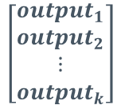
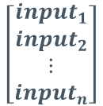
Cost function
Let’s consider this generic representation of a neuronal network.
n→m₁
m₁→m₂
m₂→m₃
m_{p-1}→m_{p}
m_{p}→k
$$\left[\begin{matrix}{input}_{1} \\ {input}_{2} \\ \begin{aligned}⋮ \\ {input}_{n}\end{aligned}\end{matrix}\right]$$
$$\left[\begin{matrix}{output}_{1} \\ {output}_{2} \\ \begin{aligned}⋮ \\ {output}_{k}\end{aligned}\end{matrix}\right]$$
Input Layer
Hidden Layers
Output Layer
To simplify this representation, let’s consider that this neuronal network is in fact a function – and lets call that function NN_{w}

Slide 39

Cost function
This means that we can represent a neuronal network in a mathematical way as follows:
Now, lets consider that our training set looks like this:
$$NN_{w}\left(input\right)=output, NN:R^{n}→R^{k}, with input=\left[\begin{aligned}{input}_{1} \\ {input}_{2} \\ ⋮ \\ {input}_{n}\end{aligned}\right] and output=\left[\begin{aligned}{output}_{1} \\ {output}_{2} \\ ⋮ \\ {output}_{k}\end{aligned}\right]$$
Entry | Input₁ | Input₂ | … | Input_{n} | Output₁ | Output₂ | … | Output_{k}
#1
#2
…
#m

Slide 40
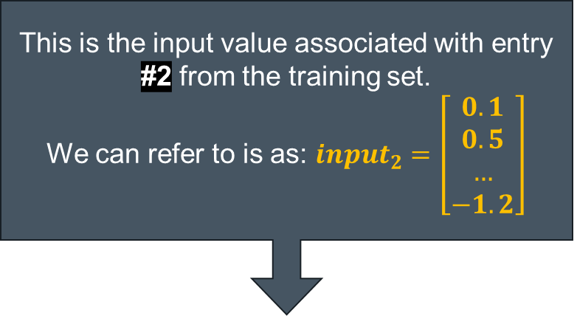
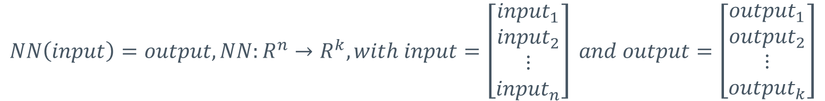
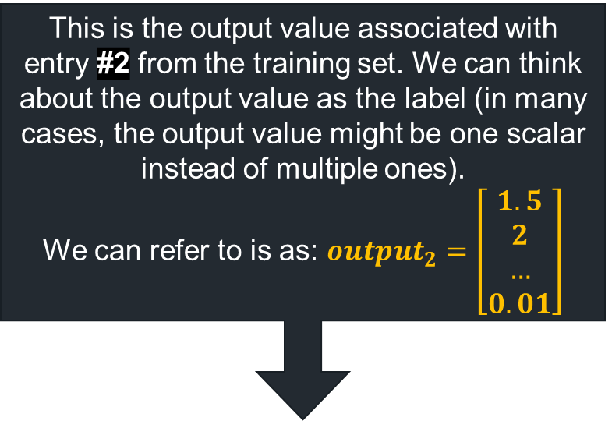
Cost function
This means that we can represent a neuronal network in a mathematical way as follows:
Now, lets consider that our training set looks like this:
This is the output value associated with entry #2 from the training set. We can think about the output value as the label (in many cases, the output value might be one scalar instead of multiple ones).
We can refer to is as: ${output}_{2}=\left[\begin{aligned}1.5 \\ 2 \\ … \\ 0.01\end{aligned}\right]$
$$NN\left(input\right)=output, NN:R^{n}→R^{k}, with input=\left[\begin{aligned}{input}_{1} \\ {input}_{2} \\ ⋮ \\ {input}_{n}\end{aligned}\right] and output=\left[\begin{aligned}{output}_{1} \\ {output}_{2} \\ ⋮ \\ {output}_{k}\end{aligned}\right]$$
This is the input value associated with entry #2 from the training set.
We can refer to is as: ${input}_{2}=\left[\begin{aligned}0.1 \\ 0.5 \\ … \\ −1.2\end{aligned}\right]$
Entry | Input₁ | Input₂ | … | Input_{n} | Output₁ | Output₂ | … | Output_{k}
#1
#2 | 0.1 | 0.5 |  | -1.2 | 1.5 | 2 |  | 0.01
…
#m

Slide 41

Cost function
For the entry #2 from the training set, we will obtain the following equation:
$$NN_{w}\left( \left[\begin{aligned}0.1 \\ 0.5 \\ ⋮ \\ −1.2\end{aligned}\right] \right)=\left[\begin{aligned}{output}_{1} \\ {output}_{2} \\ ⋮ \\ {output}_{k}\end{aligned}\right]$$
This is also called predicted value

Slide 42


Cost function
For the entry #2 from the training set, we will obtain the following equation:
Ideally, we would like the result of NN function to be:
$$NN_{w} \left( \left[\begin{aligned}0.1 \\ 0.5 \\ ⋮ \\ −1.2\end{aligned}\right] \right)=\left[\begin{aligned}{output}_{1} \\ {output}_{2} \\ ⋮ \\ {output}_{k}\end{aligned}\right]$$
$$NN_{w} \left( \left[\begin{aligned}0.1 \\ 0.5 \\ ⋮ \\ −1.2\end{aligned}\right] \right)=\left[\begin{aligned}1.5 \\ 2 \\ ⋮ \\ 0.01\end{aligned}\right]$$
Entry | Input₁ | Input₂ | … | Input_{n} | Output₁ | Output₂ | … | Output_{k}
#1
#2 | 0.1 | 0.5 |  | -1.2 | 1.5 | 2 |  | 0.01
…
#m

Slide 43
Cost function
For the entry #2 from the training set, we will obtain the following equation:
Ideally, we would like the result of NN function to be:
$$NN_{w} \left( \left[\begin{aligned}0.1 \\ 0.5 \\ ⋮ \\ −1.2\end{aligned}\right] \right)=\left[\begin{aligned}{output}_{1} \\ {output}_{2} \\ ⋮ \\ {output}_{k}\end{aligned}\right]$$
This actually translates that we need to find a way for the output vector (the prediction) to be closer to what we expect.
$$NN_{w} \left( \left[\begin{aligned}0.1 \\ 0.5 \\ ⋮ \\ −1.2\end{aligned}\right] \right)=\left[\begin{aligned}1.5 \\ 2 \\ ⋮ \\ 0.01\end{aligned}\right]$$

Slide 44

Cost function
We will use:
X for input
Y for prediction. Y =NN_{w}(x)
t for target (expected value)
$$NN\left( \left[\begin{aligned}x_{1} \\ x_{2} \\ ⋮ \\ x_{n}\end{aligned}\right]\right)=\left[\begin{aligned}y_{1} \\ y_{2} \\ ⋮ \\ y_{k}\end{aligned}\right], or NN_{w}\left( x\right)=y$$
and we need to compare this to $expected(t)=\left[\begin{aligned}t_{1} \\ t_{2} \\ ⋮ \\ t_{k}\end{aligned}\right]$

Slide 45
Cost Functions
What is a cost (loss) function?:
It quantifies how well or poorly a neural network is performing in terms of making predictions.
The primary purpose of the loss function is to measure the discrepancy between the network's predicted outputs and the actual target values (ground truth).
A change of weights affects the cost function even if the number of (in)correctly classified elements doesn’t change.

Slide 46

Cost function
One well known cost function is Mean Squared Error function:
Observations:
The cost is always positive
The closest the prediction vector is to the expected one, the closest the MSE will be to 0
Predictions that are far from target are penalized more
$$MSE=\frac{1}{k}\sum_{i=1}^{k}{{\left(t_{i}−y_{i}\right)}^{2}}$$
Notes:
Variatia este media patratelor distantelor fata de medie
Daca vrem sa scadem distanta, ar fi echivalent cu a scadea media
Explica variant: cu 7, 1, -6, -2 si 4, 4, 4, 4

Slide 47

Cost function
Mean Squared Error has some advantages:
Continuous and differentiable
Resembles the variance formula from regression (we can look at this formula as a way to evaluate how far the input vector is from a hyperplane defined by the network).
In practice, the MSE formula uses 1/2k instead of 1/k to allow easy derivation:
$$MSE=\frac{1}{2×k}\sum_{i=1}^{k}{{\left(y_{i}−t_{i}\right)}^{2}}$$

Slide 48
Cost Functions
Mean Square Error:
Advantages:
Primarily used for regression tasks
Penalizes Larger Errors: MSE squares the error, so larger errors have a disproportionately larger effect on the loss.
MSE is a convex function, which means that any local minimum is also a global minimum.
Disadvantages:
Very sensitive to outliers: A single large error can dominate the loss and lead to a model that performs poorly on the majority of the data

Slide 49
Gradient Descent

Slide 50



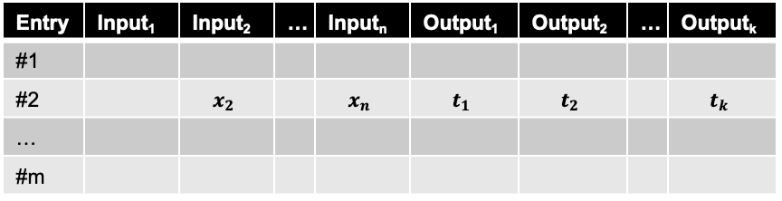
Gradient Descent
The cost function tells us how bad we’re classifying an element. We can use this metric to tells us how bad we’re classifying a minibatch, or the entire dataset.
$$y_{i}=NN\left({\left[\begin{aligned}x_{1} \\ x_{2} \\ ⋮ \\ x_{n}\end{aligned}\right]}_{i}\right)$$
$${t_{i}=\left[\begin{aligned}t_{1} \\ t_{2} \\ ⋮ \\ t_{k}\end{aligned}\right]}_{i}$$
Entry | Input₁ | Input₂ | … | Input_{n} | Output₁ | Output₂ | … | Output_{k}
#1
#2 |  | $$x_{2}$$ |  | $$x_{n}$$ | $$t_{1}$$ | $$t_{2}$$ |  | $$t_{k}$$
…
#m
$$MSE_{batch}=\frac{1}{2m}\sum_{i=1 }^{m}{\frac{1}{k}\sum_{j=1}^{k}{{\left(y_{i,j}−t_{i,j}\right)}^{2}}}$$
Where: * m is the size of the minibatch * y_{i,j,} is the j-th element from the output vector of the i-th input * t_{i,j} is the j-th element from the target vector for the i-th element

Slide 51

Gradient Descent
The cost function tells us how bad we’re classifying an element. We can use this metric to tells us how bad we’re classifying a minibatch, or the entire dataset.
$$y_{i}=NN\left({\left[\begin{aligned}x_{1} \\ x_{2} \\ ⋮ \\ x_{n}\end{aligned}\right]}_{i}\right)$$
$${t_{i}=\left[\begin{aligned}t_{1} \\ t_{2} \\ ⋮ \\ t_{k}\end{aligned}\right]}_{i}$$
Entry | Input₁ | Input₂ | … | Input_{n} | Output₁ | Output₂ | … | Output_{k}
#1
#2 |  | $$x_{2}$$ |  | $$x_{n}$$ | $$t_{1}$$ | $$t_{2}$$ |  | $$t_{k}$$
…
#m
$$MSE_{batch}= \frac{1}{2m}\sum_{x}{{|\left|t_{x}−y_{x}\right||}^{2}}$$
A shorter notation
Notes:
Variatia este media patratelor distantelor fata de medie
Daca vrem sa scadem distanta, ar fi echivalent cu a scadea media
Explica variant: cu 7, 1, -6, -2 si 4, 4, 4, 4

Slide 52
Gradient Descent
Mean Square Error:
So having a cost function we know how bad we’re classifying the entire dataset.
The training is no longer driven by directly comparing prediction and output, as in perceptron, but by the Cost Function.
This is an optimization problem. There are multiple ways to minimize/maximize a function. Neural networks use gradient descent.
Minimize the cost function
=
Increase Model Accuracy on training set
Notes:
Hill Climibging

Slide 53
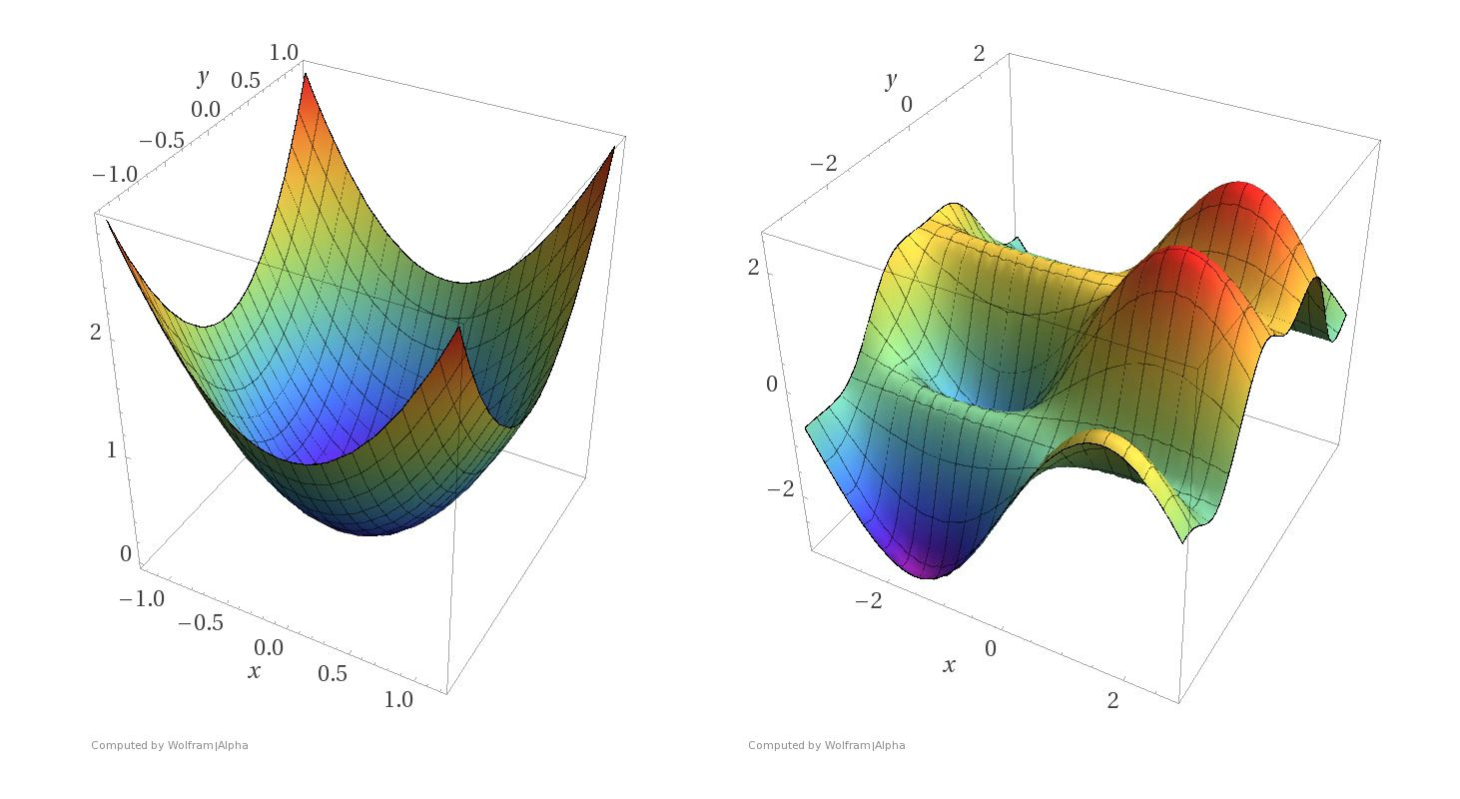

Loss Functions
Examples of graphs of loss functions with only 2 weights
Source: https://blog.paperspace.com/intro-to-optimization-in-deep-learning-gradient-descent/
Notes:
The first two are convex, only a global minima.
The second is close to actual cost function

Slide 54
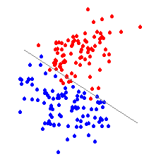
Gradient Descent
OBS: We have two functions:
1. Function that maps the input to an output:
This is what we aim to obtain: Is what we’ve previously defined by NN_{w}.
An example: a function that assigns a color to a point with 2 coordinates.
This is a function of the input (x) and we’re interested in the output (y)
We do not know how this function should look like, so we change the weights to find the best function. Each change of weights, generates a new function of the input.
A move along the input of the graph of the function is equivalent to predicting another input

Slide 55
Gradient Descent
2. A Cost function
This is a function of the function we’re trying to find (NN_{w}).
The output of this function is a value that shows the discrepancy between the output of the first function (neural network) and the target.
The cost function doesn’t change during training.
A move along this graph is a change of weights in the neural network → this changes the first function (NN_{w})
Source: https://blog.paperspace.com/intro-to-optimization-in-deep-learning-gradient-descent/

Slide 56

Gradient Descent
Example: How reduction in cost function translates to an improvement of the target function
https://www.linkedin.com/pulse/deep-learning-optimization-algorithms-gradient-descent-shashi-singh/

Slide 57
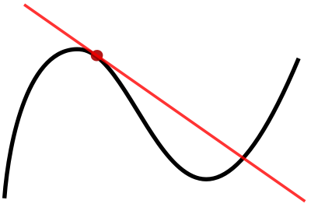
Gradient Descent
What is a gradient?
A gradient is just a fancy word for derivate ☺
The gradient (first derivative) determines the slope of the tangent of the graph of the function. (points in the direction of the greatest rate of increase)
The intuition behind this method is to take a step in the opposite direction
Notes:
Determina directia in care creste functia, sau mai exact, panta

Slide 58

Gradient Descent:
The cost function is a function of many variables. We need to know how to compute the derivative for a function of many variable
$$f(x_{1},x_{2}…x_{n})$$
In this case we can compute a partial derivative (where we will consider only one of the parameter from function f as variable, and the rest of them will be considered constant values).
We will use the following symbol to represent this kind of partial derivative function:$∂$
For example: $f\left(x_{1},x_{2}…x_{n}\right), then \frac{∂f}{∂x_{k}} means$ the derivative of function f with respect to parameter x_{k}

Slide 59
Basic calculus notions
It’s important to highlight that there are several notation for derivative functions:
Notation | f (x) derivative | f (x, y, z) derivative with respect to y
Lagrange | $$f′(x)$$ | $$f_{y}(x,y,z)$$
Leibniz | $$\frac{∂f}{∂x}$$ | $$\frac{∂f}{∂y}$$
D-Notation (Euler) | $$Df or D(f)$$ | $$D_{y}f or D_{y}(f)$$

Slide 60

Basic calculus notions
If $f\left(x_{1},x_{2}…x_{n}\right), then \frac{∂f}{∂x_{k}} means$ the derivative of function f with respect to parameter x_{k}
It is important to notice that most likely: $\frac{∂f}{∂x_{i}}≠\frac{∂f}{∂x_{j}}, if i≠j$
As a standard notation we can also write this type of derivative as:
$$\frac{∂f}{∂x_{k}}=\frac{∂(the actual f function)}{∂x_{k}}$$

Slide 61

Basic calculus notions
Let’s consider the following example:
$$f\left(x,y\right)=x^{2}+2y$$
Let’s calculate the derivative of f with respect to x
$$\frac{∂f}{∂x}=\frac{∂(x^{2}+2y)}{∂x}=\frac{∂}{∂x}\left(x^{2}\right)+\frac{∂}{∂x}\left(2y\right)=\frac{∂}{∂x}\left(2x\right)+\frac{∂}{∂x}\left(0\right)$$

Slide 62

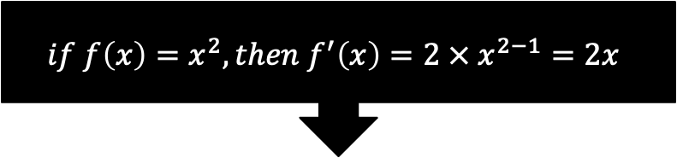
Basic calculus notions
Let’s consider the following example:
$$f\left(x,y\right)=x^{2}+2y$$
Let’s calculate the derivative of f with respect to x
$$\frac{∂f}{∂x}=\frac{∂(x^{2}+2y)}{∂x}=\frac{∂}{∂x}\left(x^{2}\right)+\frac{∂}{∂x}\left(2y\right)=\frac{∂}{∂x}\left(2x\right)+\frac{∂}{∂x}\left(0\right)$$
$$if f\left(x\right)=x^{2}, then f^{′}\left(x\right)=2 × x^{2−1}=2x$$

Slide 63
Basic calculus notions
Let’s consider the following example:
$$f\left(x,y\right)=x^{2}+2y$$
Let’s calculate the derivative of f with respect to x
$$\frac{∂f}{∂x}=\frac{∂(x^{2}+2y)}{∂x}=\frac{∂}{∂x}\left(x^{2}\right)+\frac{∂}{∂x}\left(2y\right)=\frac{∂}{∂x}\left(2x\right)+\frac{∂}{∂x}\left(0\right)$$
In this case “y” is a constant (as we compute the derivate of f with respect to x. As such, the derivation of a constant is 0

Slide 64

Basic calculus notions
Let’s consider the following example:
$$f\left(x,y\right)=x^{2}+2y$$
Let’s calculate the derivative of f with respect to x
$$\frac{∂f}{∂x}=2x$$

Slide 65

Basic calculus notions
Let’s consider the following example:
$$f\left(x,y\right)=x^{2}+2y$$
Now let’s calculate the derivative of f with respect to y
$$\frac{∂f}{∂y}=\frac{∂(x^{2}+2y)}{∂y}=\frac{∂}{∂y}\left(x^{2}\right)+\frac{∂}{∂y}\left(2y\right)=\frac{∂}{∂y}\left(0\right)+\frac{∂}{∂y}\left(2\right)$$

Slide 66
Basic calculus notions
Let’s consider the following example:
$$f\left(x,y\right)=x^{2}+2y$$
Now let’s calculate the derivative of f with respect to y
$$\frac{∂f}{∂y}=\frac{∂(x^{2}+2y)}{∂y}=\frac{∂}{∂y}\left(x^{2}\right)+\frac{∂}{∂y}\left(2y\right)=\frac{∂}{∂y}\left(0\right)+\frac{∂}{∂y}\left(2\right)$$
In this case “x” is a constant (as we compute the derivate of f with respect to y. As such, the derivation of a constant is 0

Slide 67
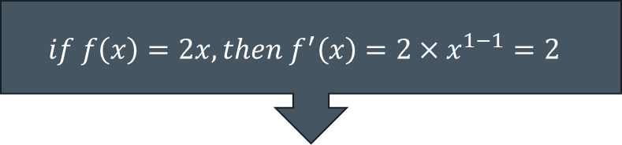
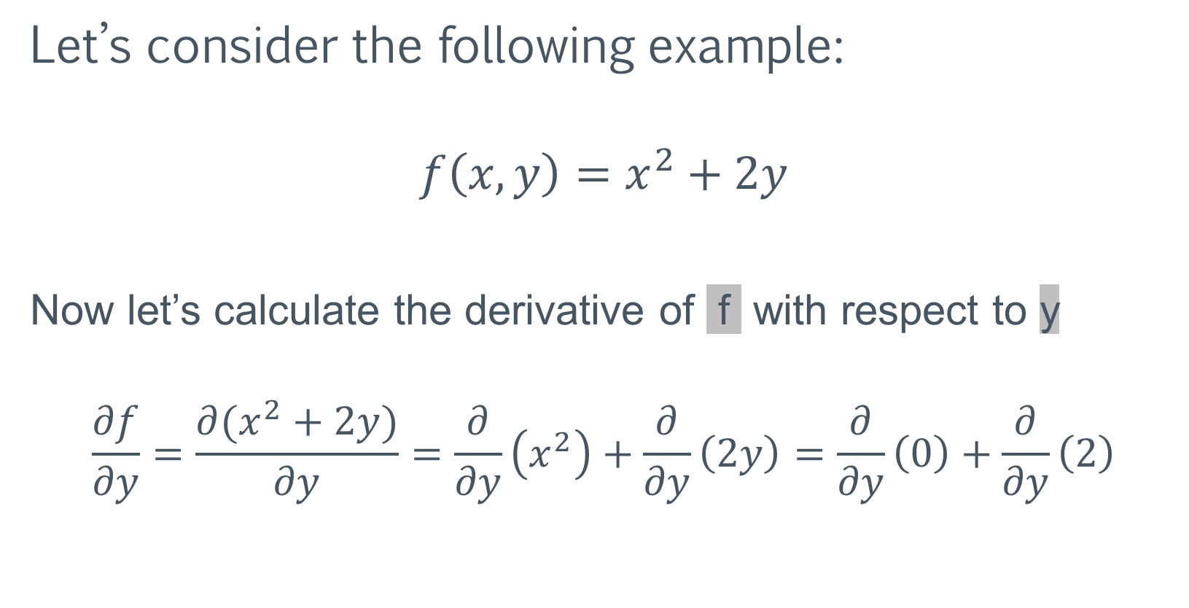
Basic calculus notions
Let’s consider the following example:
$$f\left(x,y\right)=x^{2}+2y$$
Now let’s calculate the derivative of f with respect to y
$$\frac{∂f}{∂y}=\frac{∂(x^{2}+2y)}{∂y}=\frac{∂}{∂y}\left(x^{2}\right)+\frac{∂}{∂y}\left(2y\right)=\frac{∂}{∂y}\left(0\right)+\frac{∂}{∂y}\left(2\right)$$
$$if f\left(x\right)=2x, then f^{′}\left(x\right)=2×x^{1−1}=2$$

Slide 68

Basic calculus notions
Let’s consider the following example:
$$f\left(x,y\right)=x^{2}+2y$$
As a result:
$$\frac{∂f}{∂x}=2x, \frac{∂f}{∂y}=2$$

Slide 69

Basic calculus notions
Now let's revisit the initial discussion about a function that we would like to minimize, but use a function with multiple parameters: $f\left(x_{1},x_{2}…x_{n}\right)$
If $x_{1}$ changes with $Δx_{1}$, $x_{2}$ with $Δx_{2} …$ and $x_{n}$with $Δx_{n}$then, the function f changes by :
$Δf\text{≈ }\frac{∂f}{∂x_{1}}Δx_{1}+\frac{∂f}{∂x_{2}}Δx_{2}+. . .+\frac{∂f}{∂x_{n}}Δx_{n}$
Notes:
Ecuatia este cu atat mai adevarata cu cat modificarile sunt mai mici. De fapt, eroarea scade cu patratul modificarilor. O modificare de 2 ori mai mica, scade eroarea de aproxiamre de 4 ori mai mult
Bazata pe teorema lui taylor

Slide 70
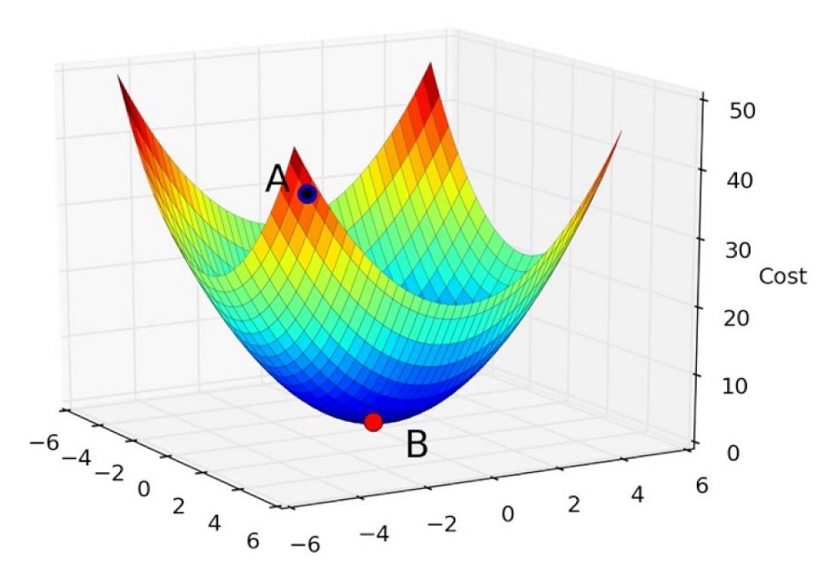

Gradient Descent
Minimizing the Cost function:
Suppose the Cost functions has only two variables (w₁ and w₂ ) and its geometric representation is a quadratic bowl.
If we move in the direction y₁ by $Δy1$ and in the direction y₂ by $Δy2$ then
$ΔC\left(y1, y2\right) \text{≈ }\frac{∂C}{∂y1}Δy1+\frac{∂C}{∂y2}Δy2$
Notes:
Ca sa minimizam functia, trebuie sa alegem $Δv1$ si $Δv2$ astfel incat $ΔC$ sa fie negativ

Slide 71

Gradient Descent
We can group the partial derivates and the changes we’ve made in two vector
$∇C=(\frac{∂C}{∂y1}$, $\frac{∂C}{∂y2}$)
$Δy=(Δy1, Δy2)$
We can rewrite the previous equation as a dot product:
$ΔC\left(y1, y2\right) \text{≈ }\frac{∂C}{∂y1}Δw1+\frac{∂C}{∂y2}Δy2$ = $∇C⋅Δy$
Notes:
Ca sa minimizam functia, trebuie sa alegem $Δv1$ si $Δv2$ astfel incat $ΔC$ sa fie negativ
NablaC = cum variaza functia (vector)
$Δv$ cu cat modific parametrii
Produisul scalar dintre cei doi vectori, ne da cum variaza $ΔC$
Cum vrem ca $ΔC$ sa fie negativ, putem allege $Δv$ ca fiind $η∇C$

Slide 72

Gradient Descent
Since we want to always move downwards (minimizing C function) we want $ΔC$ to be negative.
$ΔC\left(y1, y2\right) \text{≈ }$ $∇C⋅Δy <0$
The only thing we can change is $Δy$. By choosing
$$Δy=−η∇C$$
Where $η$is a small number, called learning rate, we can make sure that $ΔC$ will be negative

Slide 73

Gradient Descent
Minimizing the Cost function:
So, by adjusting y1 and y2 such that $Δy=−η∇C$ will always lead to a smaller value for C.
Repeating the above step multiple times drives us to a local minimum
The learning rate must be small enough to not jump over the minimum
Even though we have used just two variables, the same principle can be used for any derivable Cost function of many variables

Slide 74


Gradient Descent
Minimizing the Cost function:
The problem is that we do not change y directly. Y is the output of the neural network
So, to change y, we need to change w. So we’re interested in changing w to minimize the Cost function.
$$y_{x}=NN_{w}\left({\left[\begin{aligned}x_{1} \\ x_{2} \\ ⋮ \\ x_{n}\end{aligned}\right]}_{}\right)$$
$$MSE_{batch}= \frac{1}{2m}\sum_{x}{{|\left|t_{x}−y_{x}\right||}^{2}}$$

Slide 75

Gradient Descent
Minimizing the Cost function:
So we’re interested in computing $\frac{dC}{dw}$ .
This will give us how the Cost function is affected by w. Adjusting the weight in the opposite direction will minimize the cost function.
$w=w−η\frac{dC}{dw}$ where $η$ is a learning rate
Performing this for a number of iterations will take us to a local minimum.

Slide 76
Gradient Descent
Minimizing the Cost function:
As we’ve previously said, NN_{w} is just a function.
So we need to compute the partial derivative of a compound function
MSE(NN_{w}(w, x)) with respect to w

Slide 77

Basic calculus notions
Let’s see some basic ways to compute the derivate (f’) of a compound function, denoted by f:
The chain rule
$$f\left(x\right)=g\left(h\left(x\right)\right), with g,h:R→R,$$
$$then f^{′}\left(x\right)=g′\left(h\left(x\right)\right)×h^{′}\left(x\right)$$
using Leibniz notation
$\frac{∂g}{∂x}=\frac{∂g}{∂h}∙\frac{∂h}{∂x}$
OBS: this rules refers to chained functions (a function that gets an input, returns an output and then the output is the input for another function)

Slide 78

Basic calculus notions
Let’s see some basic ways to compute the derivate (f’) of a compound function, denoted by f:
Example:
Let’s assume we have the following functions:
$h\left(x\right)=x^{2},$ $g\left(x\right)=2x+7$
and we want to compute: $f\left(x\right)=g\left(h(x)\right)$.
For $h\left(x\right)=x^{2},\frac{∂h\left(x\right)}{∂x}=2x;$ For $g\left(x\right)=2x+7,\frac{∂g\left(x\right)}{∂x}=2$
Then $\frac{∂f\left(x\right)}{∂x}=\frac{∂g\left(x\right)}{∂h(x)}×\frac{∂h\left(x\right)}{∂x}=2x × 2=4x$
Notes:
Transforma asta in notatie leibnits

Slide 79

Gradient Descent
Example:
Performing gradient descent on MSE for the Adaline perceptron.
The activation function (identity function for Adaline):
$y=z=wx+b$
We will use the mean square error as the cost functions
$MSE=\frac{1}{2n}\sum_{x}{{\left(t_{x}−y_{x}\right)}^{2}}$

Slide 80

Gradient Descent
Example:
Performing gradient descent for the Adaline perceptron
1. Compute the gradient $∇C$
$∇C=(\frac{dC}{dw}$,$\frac{dC}{db}$)
using the chain rule:
$\frac{∂C}{∂w}=\frac{∂MSE}{∂y_{x}}∙\frac{∂y_{x}}{∂w}$ and $\frac{∂C}{∂b}=\frac{∂MSE}{∂y_{x}}∙\frac{∂y_{x}}{∂b}$

Slide 81

Gradient Descent
Example:
Performing gradient descent for the Adaline perceptron
1a. Compute the gradient $\frac{∂MSE}{∂y_{x}}$
$$\frac{∂MSE}{∂y_{x}}=\frac{d\left(\frac{1}{2n}\sum_{x}{{\left(t_{x}−y_{x}\right)}^{2}}\right)}{dy_{x}}=\frac{1}{2n}2\sum_{x}{(t_{x}−y_{x})′}=\frac{1}{n}\sum_{x}{(t_{x}−y_{x})(−y_{x})′}$$
$$\frac{∂MSE}{∂y_{x}}=\frac{1}{n}\sum_{x}{(t_{x}−y_{x})(−1)}=−\frac{1}{n}\sum_{x}{(t_{x}−y_{x})}$$

Slide 82

Gradient Descent
Example:
Performing gradient descent for the Adaline perceptron
1b. Compute the gradient $\frac{∂y_{x}}{∂w}$ and $\frac{∂y_{x}}{∂b}$
$$\frac{∂y_{x}}{∂w}=\frac{∂\left(wx+b\right)}{∂w}=x$$
$$\frac{∂y_{x}}{∂b}=\frac{∂\left(wx+b\right)}{∂b}=1$$

Slide 83

Gradient Descent
Example:
Performing gradient descent for the Adaline perceptron
2. Choose a learning rate $η$
3. For a fixed number of iterations:
adjust w: $w=w−η\frac{dC}{dw}=w+\frac{η}{n}\sum_{x}{\left(t_{x}−y_{x}\right)x }$
adjust b: $b=b−η\frac{dC}{db}=b+\frac{η}{n}\sum_{x}{η(t_{x}−y_{x}) }$

Slide 84

Gradient Descent
Example:
Performing gradient descent for the Adaline perceptron
2. Choose a learning rate $η$
3. For a fixed number of iterations:
adjust w: $w=w−η\frac{dC}{dw}=w+\frac{η}{n}\sum_{x}{\left(t−y\right)x }$
adjust b: $b=b−η\frac{dC}{db}=b+\frac{η}{n}\sum_{x}{η(t−y) }$
This is the same update rule we used for the Adaline in the previous course. The formula looks different since now we are averaging over all samples

Slide 85


Gradient Descent
Adaline perceptron has no input activation. How would the gradient descent algorithm work for a neuron with logistic activation
n→k
$$\left[\begin{matrix}x_{1} \\ x_{2} \\ \begin{aligned}⋮ \\ x_{n}\end{aligned}\end{matrix}\right]$$
$$\left[\begin{matrix}y_{1} \\ y_{2} \\ \begin{aligned}⋮ \\ y_{k}\end{aligned}\end{matrix}\right]$$
$$y_{x}=σ\left(z_{x}\right)=σ(wx+b)$$

Slide 86

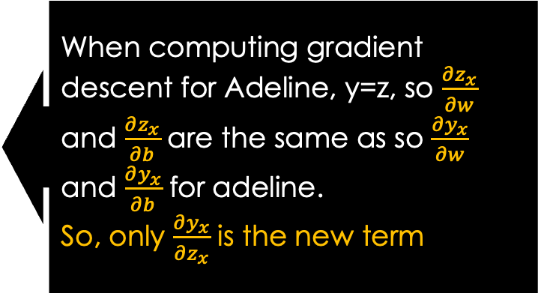
Gradient Descent
Performing gradient descent for a neuron with logistic activation
1. Compute the gradient $∇C$
$∇C=(\frac{dC}{dw}$,$\frac{dC}{db}$)
using the chain rule:
$\frac{∂C}{∂w}=\frac{∂MSE}{∂y_{x}}∙\frac{∂y_{x}}{∂w}=\frac{∂MSE}{∂y_{x}}∙\frac{∂y_{x}}{∂z_{x}}⋅\frac{∂z_{x}}{∂w}$ and
$\frac{∂C}{∂b}=\frac{∂MSE}{∂y_{x}}∙\frac{∂y_{x}}{∂b}$ = $\frac{∂MSE}{∂y_{x}}∙\frac{∂y_{x}}{∂z_{x}}⋅\frac{∂z_{x}}{∂b}$
When computing gradient descent for Adeline, y=z, so $\frac{∂z_{x}}{∂w}$ and $\frac{∂z_{x}}{∂b}$ are the same as so $\frac{∂y_{x}}{∂w}$ and $\frac{∂y_{x}}{∂b}$ for adeline.
So, only $\frac{∂y_{x}}{∂z_{x}}$ is the new term

Slide 87


Gradient Descent
Doing the math for the $σ′$
$$\frac{dσ^{′}}{dz}={\left(\frac{1}{1+e^{−z}}\right)}^{′}={(\left(1+e^{−z}\right)}^{−1})′=−1(1+e^{−z})′{\left(1+e^{−z}\right)}^{−2}=$$
$$=−\frac{1}{{\left(1+e^{−z}\right)}^{2}}{\left(1+e^{−z}\right)}^{′}=−\frac{{\left(−z\right)}^{′}e^{−z}}{{\left(1+e^{−z}\right)}^{2}}=\frac{e^{−z}}{{\left(1+e^{−z}\right)}^{2}}=\frac{1}{1+e^{−z}}∙\frac{e^{−z}}{1+e^{−z}}=$$
$$=σ\left(z\right)∙\left(\frac{1+e^{−z}}{1+e^{−z}} −\frac{1}{1+e^{−z}}\right)=σ\left(z\right)∙\left(1−σ\left(z\right)\right)$$
$σ^{′}\left(z_{}^{}\right)=y_{}^{}(1−y_{}^{})$~

Slide 88
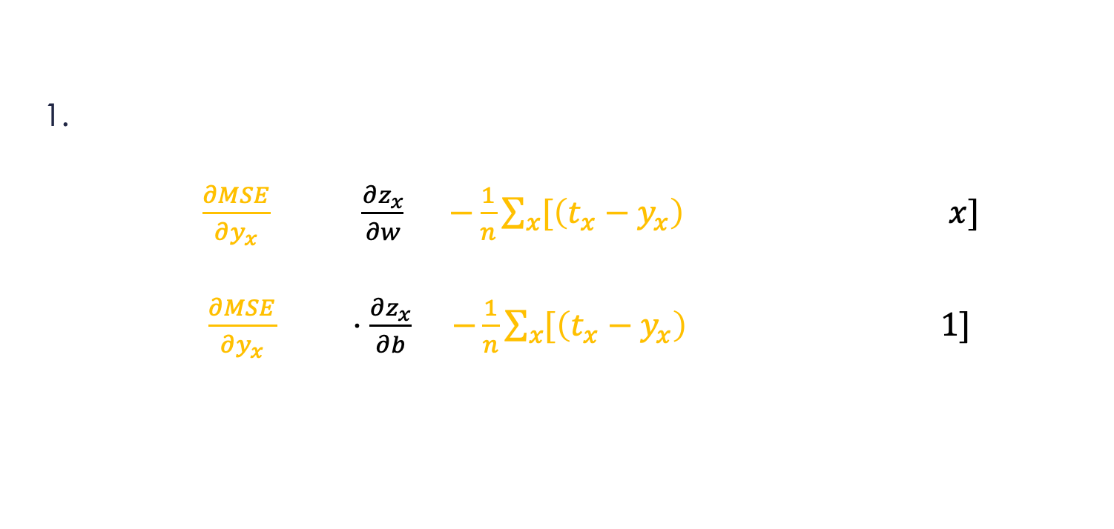
Gradient Descent
Performing gradient descent for a neuron with logistic activation
Compute the gradient $∇C$
$\frac{∂C}{∂w}=\frac{∂MSE}{∂y_{x}}∙\frac{∂y_{x}}{∂z_{x}}⋅\frac{∂z_{x}}{∂w}=−\frac{1}{n}\sum_{x}{[\left(t_{x}−y_{x}\right) }⋅(y_{x}⋅\left(1−y_{x}\right))⋅x]$
$\frac{∂C}{∂b}=\frac{∂MSE}{∂y_{x}}∙\frac{∂y_{x}}{∂b}⋅\frac{∂z_{x}}{∂b}$ = $−\frac{1}{n}\sum_{x}{[\left(t_{x}−y_{x}\right)⋅}(y_{x}⋅\left(1−y_{x}\right))⋅1]$

Slide 89

Gradient Descent
Performing gradient descent for a neuron with logistic activation
2. Choose a learning rate $η$
3. For a fixed number of iterations:
adjust w: $w=w−η\frac{dC}{dw}=w+\frac{η}{n}\sum_{x}{[\left(t_{x}−y_{x}\right) x }(y_{x}⋅\left(1−y_{x}\right))\text{]}$
adjust b: $b=b−η\frac{dC}{db}=b+\frac{η}{n}\sum_{x}{[(t_{x}−y_{x}) }(y_{x}⋅\left(1−y_{x}\right))\text{]}$
So the difference for the adeline perceptron is that we also multiply by the derivative of the activation function

Slide 90
Backpropagation
Using gradient descent we can optimize a network with just one output layer
However, can we train a network with multiple layers?

Slide 91
Backpropagation
However, can we train a network with multiple layers?
Yes, but not yet ! ☺
We know the error at the last layers, so we can update the immediate weights that affect that error
The last layer is a function of the previous. So we need to apply the chain rule again.
We need to backpropagate the error

Slide 92
Questions & Discussion

Slide 93
Bibliography
http://neuralnetworksanddeeplearning.com/
Chris Bishop, “Neural Network for Pattern Recognition”
http://sebastianraschka.com/Articles/2015_singlelayer_neurons.html
http://deeplearning.net/

